Slide 1
Employee Exit Analysis Dashboard
A data-driven approach to understanding employee attrition and improving retention strategies.
Prepared by: Swati Arya
Tool Used: PowerBI/Excel

Slide 2
Business Objective
To analyze employee attrition patterns and identify key factors influencing employee exits, workplace satisfaction, and retention opportunities.
To provide actionable insights for improving employee satisfaction and reducing attrition.

Slide 3
Problem Statement
The Department of Education, Training, and Employment (DETE), Queensland Government, Australia, conducted an exit survey to analyze employee attrition and workplace satisfaction. Wants data-driven insights to improve employee retention and workplace satisfaction.
Key Focus Areas
Employee Turnover Analysis
Workplace Satisfaction Analysis
Demographic Insights
Predictive Insights for Employee Retention

Slide 4
Dataset Understanding
Summary of Dataset Analysis:
The dataset contains 822 records and 56 columns.
The columns include:
Personal & Employment Information: ID, Separation Type, Cease Date, Start Date, Position, Region, Employment Status.
Reasons for Leaving: Career moves, dissatisfaction, work-life balance, workload, maternity, health issues, etc.
Workplace Experience Ratings: Professional development, opportunities, staff morale, workplace issues, stress, support from peers and supervisors, etc.
Demographics: Gender, Age, Aboriginal/Torres Strait/South Sea heritage, Disability, Non-English Speaking Background (NESB)

Slide 5
Data Cleaning & Preprocessing
Handled missing values by standardizing entries such as "N/A", "n/a", “Not Stated” and nulls.
Removed blank rows to maintain data quality.
Converted data types appropriately (e.g., numeric, categorical fields).
Transformed multiple columns (reasons & satisfaction factors) into a structured format using unpivoting.
Created new derived fields such as Tenure and Tenure Groups for better analysis.
Prepared a clean and analysis-ready dataset for visualization in Power BI.

Slide 6
Exploratory Data Analysis (EDA)
Performed exploratory analysis using visualizations such as bar charts, treemaps, and comparative plots.
Identified major attrition drivers, with work-life balance and unclassified reasons contributing significantly.
Analyzed tenure-based patterns, revealing high exits in both early tenure (0–5 years) and long tenure (30+ years).
Explored demographic trends, with higher attrition observed in older age groups.
Gender analysis shows higher attrition among female employees (468) compared to male employees (198).
Assessed workplace satisfaction using average scores across multiple factors.
Summarized key metrics such as employee count and average satisfaction to understand overall patterns.

Slide 7
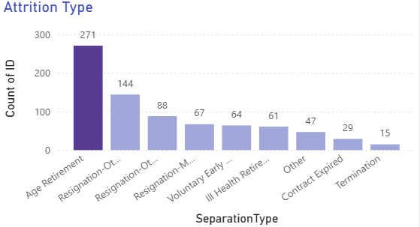
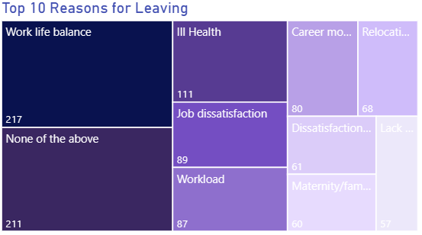
Employee Turnover Analysis
• Age retirement is the leading cause of employee exits.
• Resignations (combined categories) also contribute significantly to attrition.
• Work-life balance is the top reported reason for leaving.
• A large number of responses fall under “None of the above,” indicating potential unrecorded factors.
This indicates that while natural attrition exists, controllable factors like work-life balance still play a critical role.
A significant proportion of responses fall under ‘None of the above’ and ‘Other’, indicating that existing survey categories may not fully capture all reasons for employee exits.

Slide 8
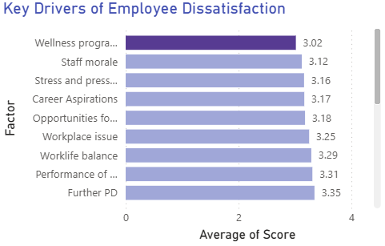
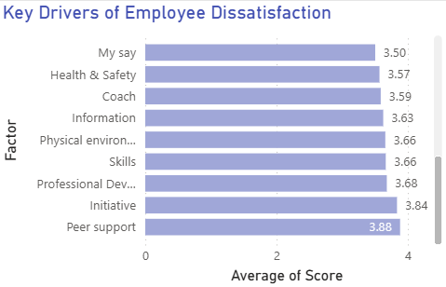
Workplace Satisfaction Analysis
Overall satisfaction scores are moderate, ranging between 3.0 to 3.88.
Wellness programs and staff morale show the lowest satisfaction levels.
Wellness programs and staff morale show the lowest satisfaction levels.
Peer support and initiative are highly rated, reflecting strong team collaboration.
The variation in satisfaction across factors indicates that while team-level support is strong, organizational-level policies such as employee voice and well-being need improvement.

Slide 9
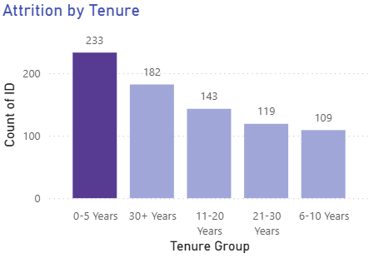
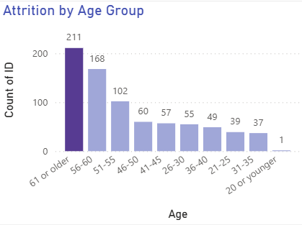
Demographic Insights
Higher attrition is observed among older age groups, particularly employees aged 56 and above.
Early tenure employees (0–5 years) show the highest exit rates.
A significant number of exits also occur among long-tenured employees (30+ years).
This indicates a mix of early attrition and retirement-driven exits.
This suggests that both early-stage retention and long-term workforce planning are important for the organization.

Slide 10
Key Insights
Work-life balance is the most significant reported reason for employee exits.
A large proportion of responses fall under “None of the above”, indicating possible gaps in survey coverage.
Attrition is driven by both early-tenure employees (0–5 years) and long-tenured employees (30+ years).
Employee exits are higher among older age groups, suggesting retirement as a key factor.
Workplace dissatisfaction is moderate, with lower scores in wellness, morale, and employee voice.

Slide 11
Recommendations
Improve work-life balance by introducing flexible working hours and remote work options.
Enhance employee feedback systems through regular surveys and open communication channels.
Strengthen onboarding programs for early-tenure employees with mentorship and training support.
Implement succession planning and knowledge transfer programs for retiring employees.
Improve employee well-being by expanding wellness programs and stress management initiatives.
Encourage employee voice by creating platforms for feedback and participation in decision-making.

Slide 12
Thank You!

